Slide 1
GOOGLE APPS
BY MADHUMITA PATRO

Slide 2
About Dataset
Context
While many public datasets (on Kaggle and the like) provide Apple App Store data, there are not many counterpart datasets available for Google Play Store apps anywhere on the web.
On digging deeper, I found out that the iTunes App Store page deploys a nicely indexed appendix-like structure to allow for simple and easy web scraping.
On the other hand, Google Play Store uses sophisticated modern-day techniques (like dynamic page load) using JQuery making scraping more challenging.

Slide 3
Content
Each app (row) has values for category, rating, size, and more.
Acknowledgements
This information is scraped from the Google Play Store. This app information would not be available without it.
Inspiration
The Play Store apps data has enormous potential to drive app-making businesses to success.
Actionable insights can be drawn for developers to work on and capture the Android market!

Slide 4
Objective
The goal of this project is to analyze the characteristics of apps on the Google Play Store, including their ratings, reviews, sizes, installation counts, and more.
The analysis will help identify trends, outliers, and patterns in the app market.

Slide 5
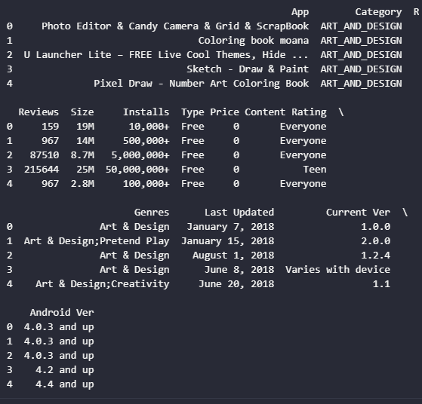
PRINT HEADS

Slide 6
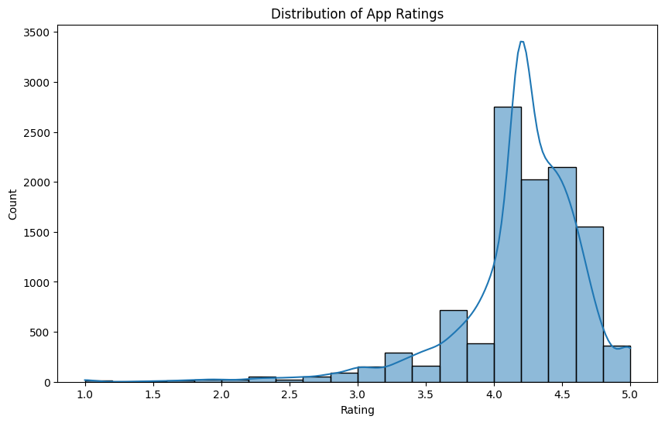
Distribution of app ratings

Slide 7
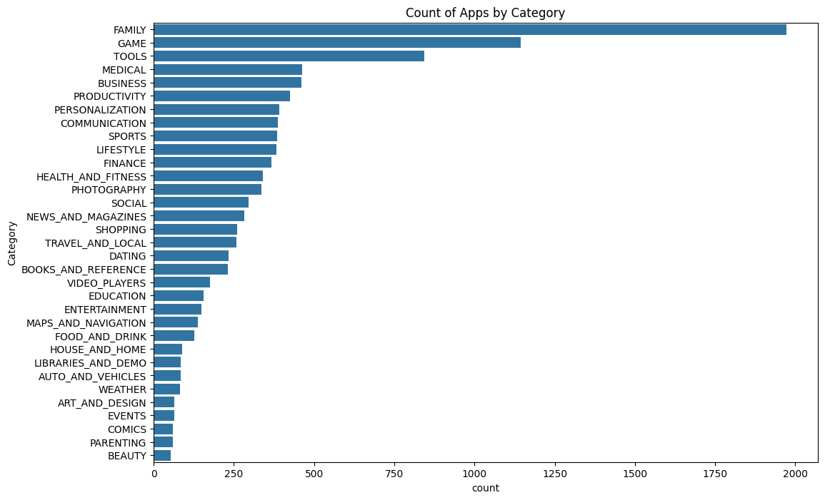
Count of apps by category

Slide 8
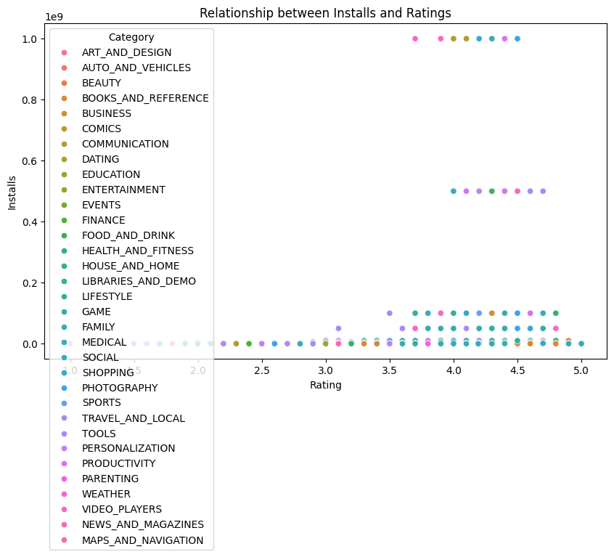
Relationship between installs and ratings

Slide 9
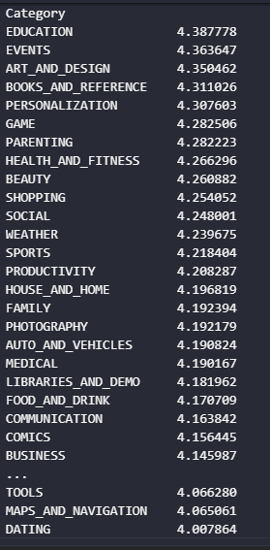
Category rating

Slide 10
Top genres
Education 549
Medical 463
Business 460

Slide 11
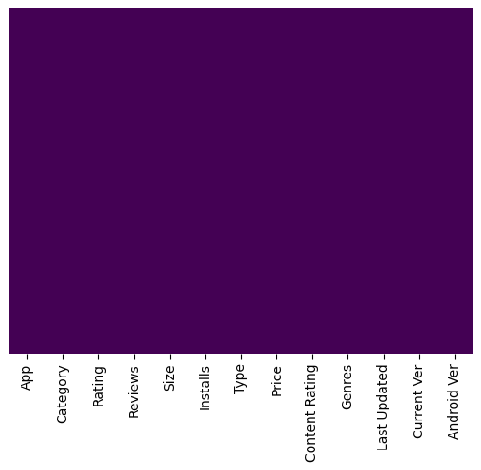

Slide 12
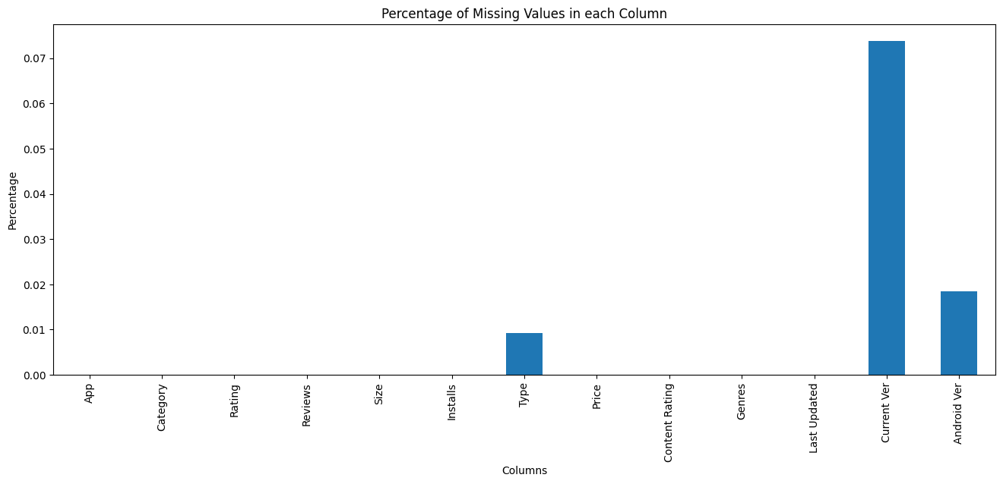

Slide 13
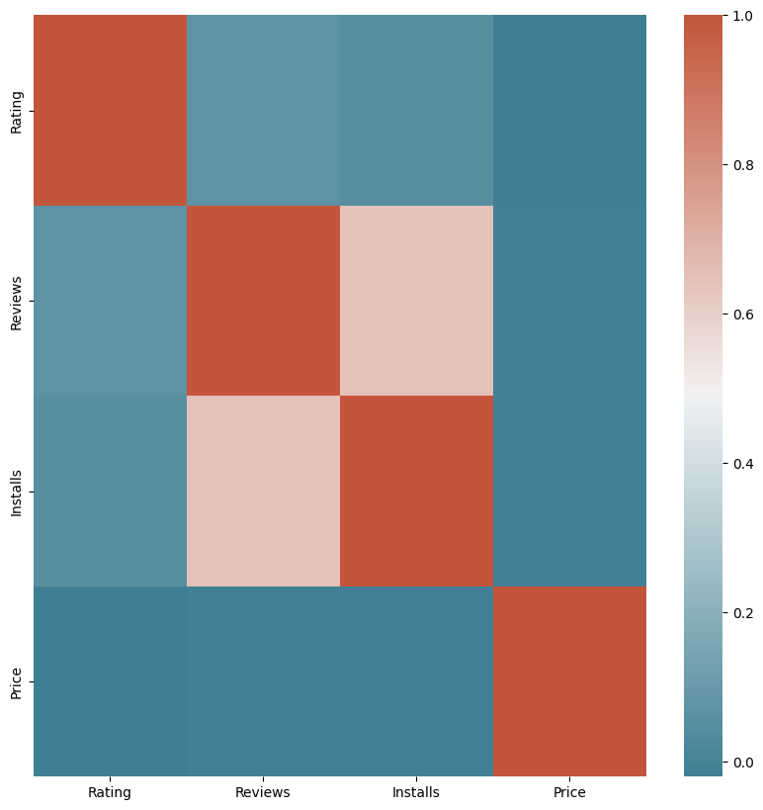

Slide 16
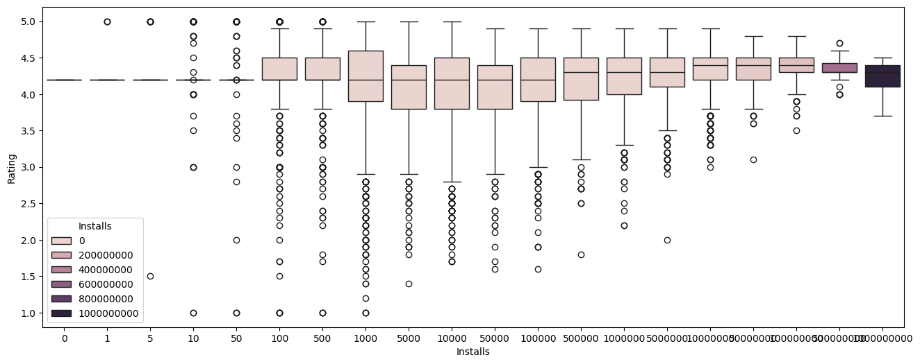

Slide 17
